Slide 1
Kinect Nerf Turret Using computer vision
Ishan Khatri & Pratiik Kaushik

Slide 2
The concept
To create a nerf turret that will track humans and fire upon them as long as they are not in a “hands up” pose.
Why a use a Kinect instead of a regular webcam?
The Kinect has powerful gesture recognition tools built into it’s API, and also contains numerous helpful cameras, including RGB, infrared, and a depth sensor

Slide 3
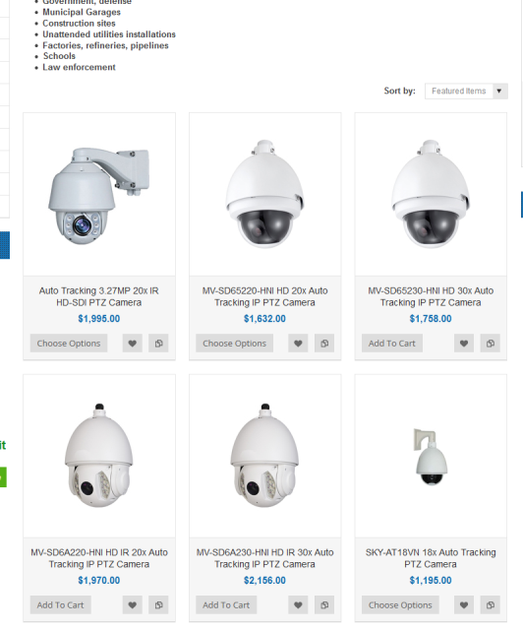
Possible applications
The Kinect turret is an extension and prototype for another project that aims to improve the evacuation of schools during crisis scenarios
I’ve called this concept of a network of intelligent cameras the “Marauders Map”

Slide 4
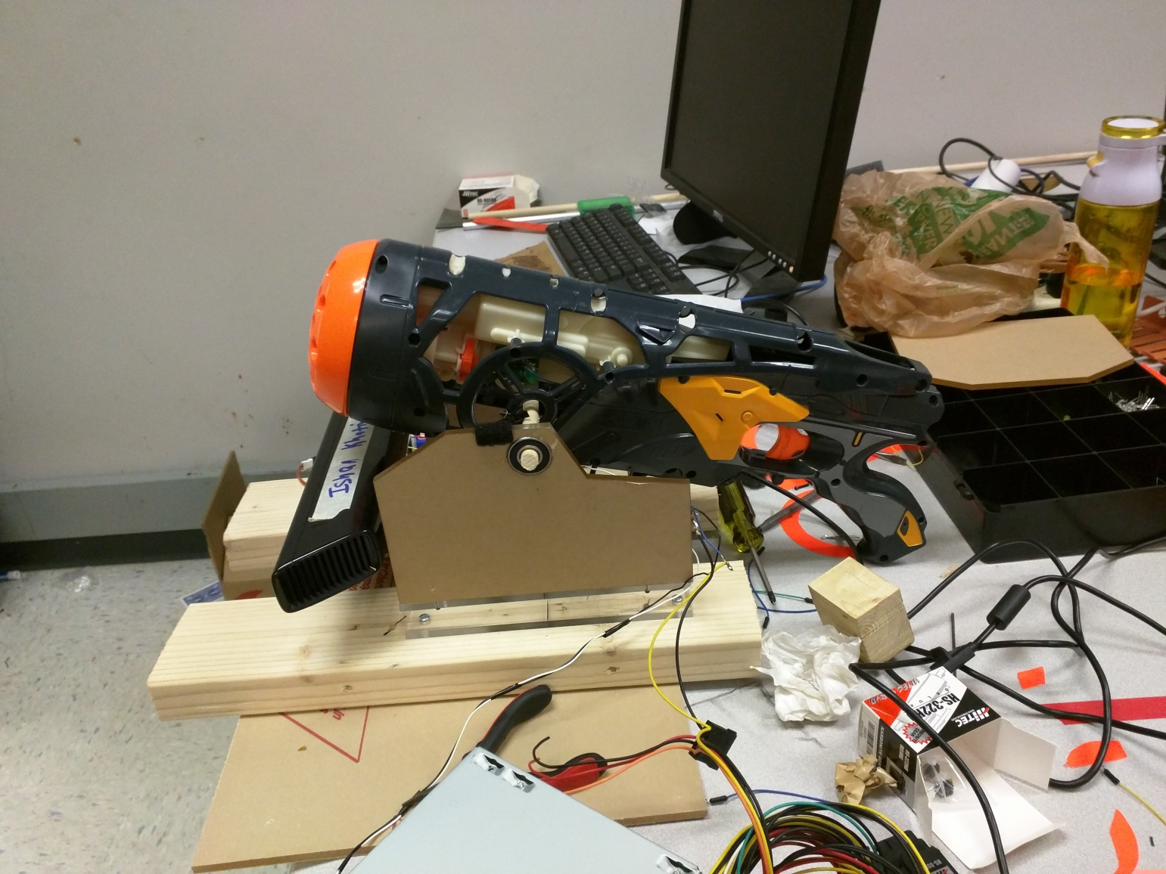
Why have a nerf gun?
Just for fun

Slide 5
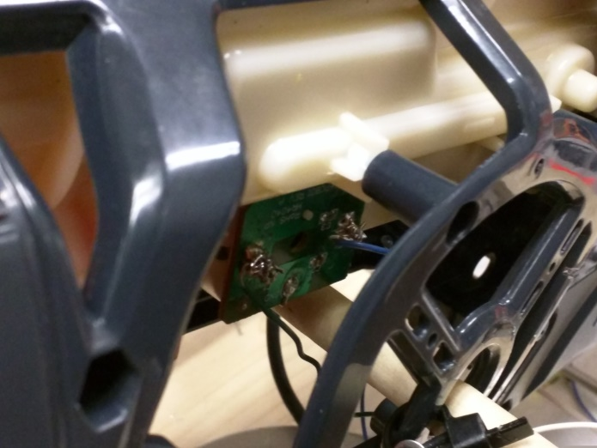
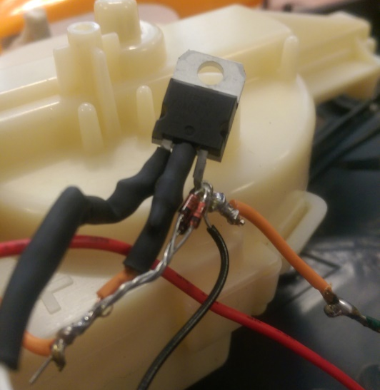
The hardware
Simple 1 servo setup w/ a ball bearing for smooth rotation
Lexan plastic exterior – created in CAD and laser cut for precision
Plywood support structure
Desktop PC power supply for power
Modified nerf gun with custom fire control circuit

Slide 6
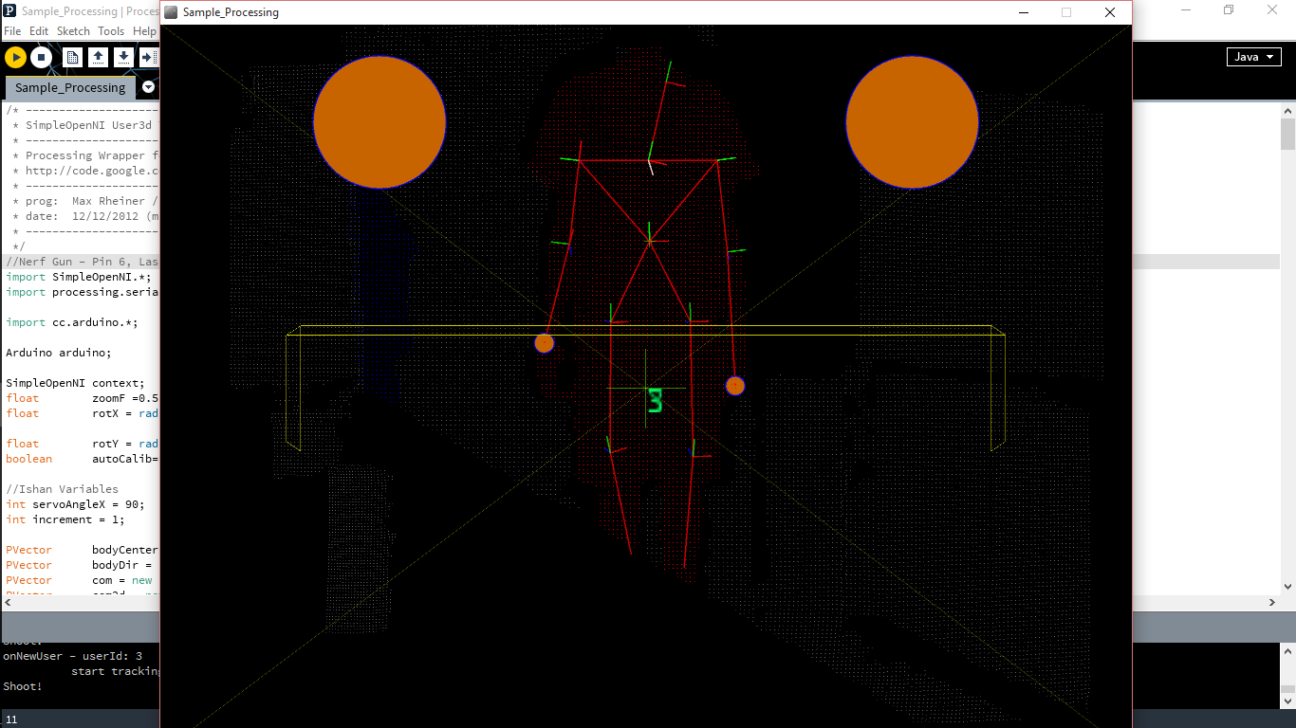
The software
Kinect Drivers from Microsoft
Simple Open NI library for Arduino
Arduino Firmatta library
Processing to interface the Kinect with the Arduino

Slide 7
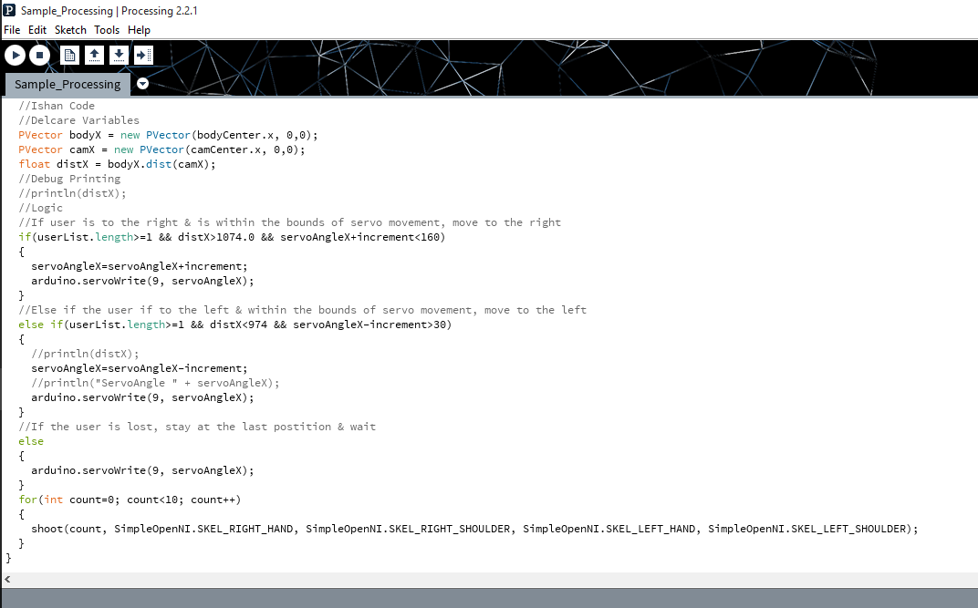
The algorithm
Simple algorithm but with real world challenges
If (user is not in the center)
Move towards the user
Repeat until user is in the center
If(user’s hands are below their shoulders)
Shoot

Slide 8
Video
https://drive.google.com/open?id=0B4YjXxlZa7wQOFlmb19mM3l3ZzA
https://drive.google.com/open?id=0B4YjXxlZa7wQZlI2RDlxdDVZX1k

Slide 9
Challenges
Hardware issues (We broke a lot of stuff :P)
The appearance and design are not as clean as we would have liked
PC Power supply was not ideal
Software issues
Kinect drivers are old and out of date & have little to no documentation
Driver software requires tweaks to work, as the X360 Kinect was not designed to work with PC’s
Arduino’s are single threaded – adds jerkiness

Slide 10
Lessons Learned
Don’t use old hardware & software!
A lot of issues could be solved by simply using the new Kinect (Xbox One) with updated drivers
Plan out the hardware beforehand
It looks ugly because it was thrown together without a plan
If(projectWorks && hadFun)
Println(“Success!”);

Slide 11
Thank you!
We’d like to thank all the people who helped us see this project to fruition
The TAs Rohan, Tom, Griffin and Andrew
And Greg the REL Supervisor

